Slide 1
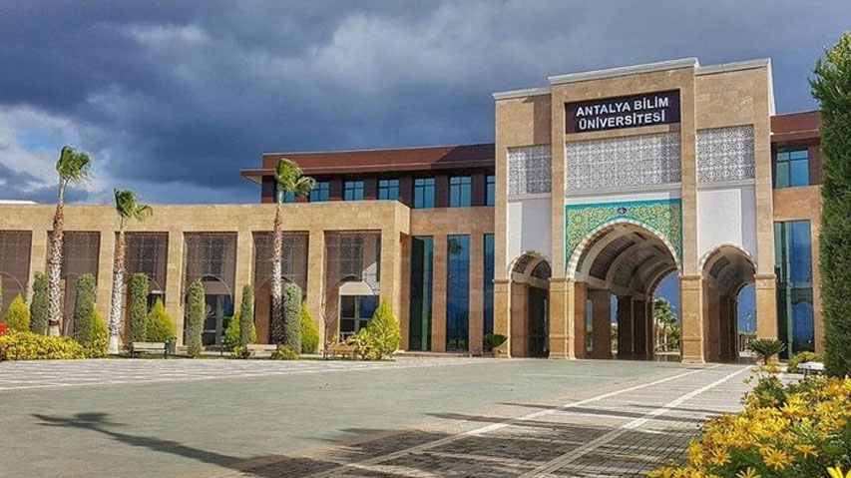
ANTALYA BILIM UNIVERSITY
Department of Civil Engineering

Slide 2




The Department of Civil Engineering
2012
100%
4 years
12
Year founded
English education
Undergraduate duration
Academic staff
Our department admits students through ÖSYM's central placement system, based on the success ranking and minimum score thresholds set for engineering faculties. Our strong academic staff includes 2 professors, 2 associate professors, 5 assistant professors, and 3 research assistants, with the aim of providing an engineering education recognized not only in Turkey but also on the international stage.

Slide 3



History
A success story from founding to internationally education
2013–2014
2016–2017
2025–2026
First Students
First Graduates
New Education System
Our department began admitting students in the 2013–2014 academic year.
Our department produced its first graduates in the 2016–2017 academic year.
As of the 2025–2026 academic year, the department transitioned to internationally accredited education and the ICE model.
The Department of Civil Engineering at Antalya Bilim University has grown steadily since its founding, and as of 2025 has transitioned to the International Co-op Education (ICE) system, achieving full integration with global education standards.

Slide 4





Why Civil Engineering?
A profession that designs, builds, manages, and creates lasting value for society
A Profession That Shapes Life
Contribution to a Sustainable Future
Engineering + Technology
Improves quality of life by designing buildings, bridges, roads, dams, airports, and infrastructure systems.
Develops environmentally friendly buildings, energy-efficient designs, and sustainable infrastructure solutions.
The opportunity to work with artificial intelligence, BIM, smart cities, earthquake engineering, and advanced construction materials.
Broad Career Opportunities
A Global Profession
Problem-Solving and Leadership
Public sector, private sector, consulting, site management, project design, R&D, and academic careers.
Civil engineers are sought-after professionals worldwide; they take part in international projects.
Builds technical knowledge, analytical thinking, project management, teamwork, and leadership skills.
WANT TO BUILD THE FUTURE?
“Engineering that turns today's projects into tomorrow's living spaces.”

Slide 5


What Sets the Program Apart
HIGHLIGHTS
100% English Education
ICE Cooperative Education Model
International Partnerships
The program is conducted entirely in English, preparing graduates for international professional and academic environments.
Students who successfully complete the first six semesters receive hands-on training at industry companies in the 7th and 8th semesters.
Student exchange opportunities are offered with 12 universities from 8 countries under Erasmus+ bilateral agreements.

Slide 6
ICE — International Cooperative Education
A new education system integrating theoretical learning with professional work experience
OPTION A · Elective Courses
In the 7th and 8th semesters, students take electives based on their interests, gaining theoretical depth and preparation for an academic career.
1st – 6th SEMESTERS
CORE AND FIELD EDUCATION
Core engineering courses in Civil Engineering are taken.
JOB-READY GRADUATE
Early exposure to the industry minimizes workplace adaptation and learning time.
OPTION B · ICE
Students receive hands-on training by working full-time at partner industry-leading companies, gaining direct work experience.

Slide 7


Mission and Vision
Our education and research goals that shape the future
Mission
Vision
The Department of Civil Engineering at ABU aims to educate civil engineers who follow current developments in engineering science and technology, are innovative, capable of analytical thinking, and committed to ethical values. In this context, the department provides its students with a contemporary educational environment that integrates research and practice in fundamental fields such as structural engineering, geotechnics, hydraulics, transportation, and environmental systems.
The ABU Department of Civil Engineering regards the strengthening of interdisciplinary collaboration and multifaceted engineering approaches, the promotion of scientific knowledge production, and the support of a lifelong learning culture as core missions, in line with the goals of sustainable development, safe built environments, and the enhancement of social welfare.
The ABU Department of Civil Engineering aspires to become a nationally and internationally respected academic center that embraces excellence in engineering education, stands out through the integration of research and practice, and incorporates digital transformation and technological innovations into its educational and research processes.
With an approach based on sustainability, innovation, and ethical values, the department continues its efforts to become an education and research unit that develops solutions sensitive to societal needs, maintains strong communication with its stakeholders, and holds a trusted position in the engineering sector through its graduates.

Slide 8
Program Scores and Placement Rankings
ÖSYM 2026 central placement data
50% TUITION SCHOLARSHIP
FULL SCHOLARSHIP
17 / 17
3 / 3
Quota / Enrolled · 100% filled
Quota / Enrolled · 100% filled
MINIMUM SCORE
SUCCESS RANK
MINIMUM SCORE
SUCCESS RANK
306.34141
292,554
384.82137
136,267
SCHOLARSHIP
MINIMUM RANK REQUIREMENT
SCHOLARSHIP
MINIMUM RANK REQUIREMENT
50% Tuition Discount
300,000
Full Scholarship
300,000
Program Type: Full-Time · Score Type: SAY · Language of Instruction: English · City: Antalya

Slide 9
Program Educational Objectives (PEO)
1
3
5
Technical Leadership
Team & Project Management
Lifelong Learning
Active roles in national and international projects within structural, geotechnical, transportation, and hydraulic sub-fields.
Collaboration across disciplines, along with project planning, management, and leadership roles.
Staying professionally up to date through graduate education, professional courses, and certifications.
2
4
Ethics & Sustainability
Digital Transformation
Responsibility in the public/private sector that is responsive to societal needs while upholding ethics and safety.
Effective use of innovative design tools and current engineering technologies.

Slide 10
Program Outcomes
Technical Capacity and Analysis
Professional and Social Responsibility
Communication and Dynamic Management
1
Basic Science and Engineering Knowledge
8
Teamwork and Leadership
2
Problem Analysis and Definition
6
Global, Environmental, and Legal Impacts
9
Effective Verbal and Written Communication
3
Creative Engineering Design
7
Engineering Ethics and Inclusivity
10
Project Management and Entrepreneurship
4
Use of Modern Tools and Information Technologies
11
Lifelong Learning
5
Research, Experimentation, and Data Interpretation

Slide 11
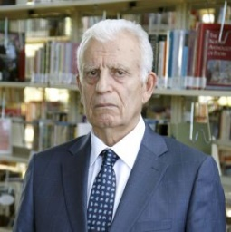
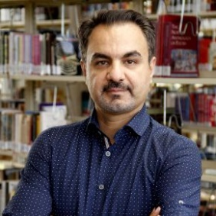
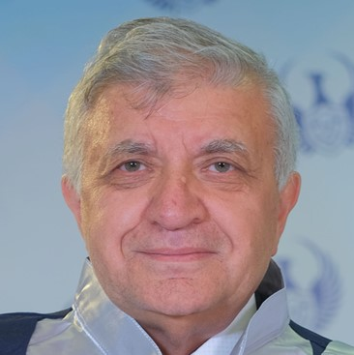
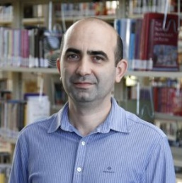
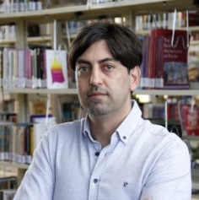
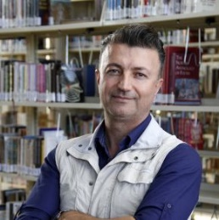

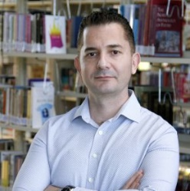
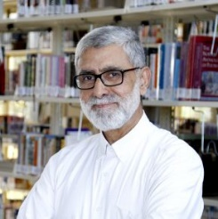
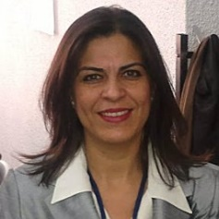
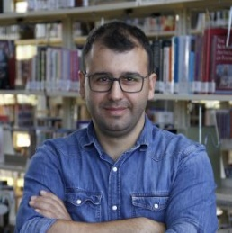
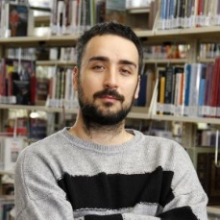
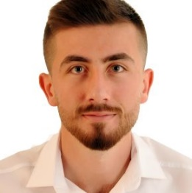
Academic Staff
3 Professors
2 Associate Professors
5 Assistant Professors
3 Research Assistants
Necati AĞIRALİOĞLU
Professor (Head of Department)
Hydrology; Hydromechanics; Water Resources
Ali DANANDEH MEHR
Professor
Hydrology; Hydromechanics; Fluid Mechanics
Mustafa KARAŞAHİN
Professor
Transportation
Emre DEMİR
Associate Professor
Transportation and Traffic
Fuad ABUTAHA
Assistant Professor (Deputy Head)
Construction Materials; Project Management; Construction Technologies
Hamid FARROKH GHATTE
Assistant Professor
Reinforced Concrete Structures; Earthquake Engineering; Structural Dynamics
Tevfik Oğuz ÖRMECİOĞLU
Assistant Professor
Optimization Techniques; Structural Mechanics; Numerical Modeling
Kazım Burç CİVELEK
Assistant Professor
Steel Structures
Abdurrahman MOHAMMED
Assistant Professor
Urban Morphology; Urban History; Urban Design and Regeneration
Gamze BİLGEN*
Associate Professor
Geotechnical Engineering
Onur ALTAY
Research Assistant
Earthquake Engineering; Reinforced Concrete Structures; Structural Dynamics
Halid AKDEMİR
Research Assistant
Water Resources and Hydraulic Structures; Fluid Mechanics
Metin TUNCER
Research Assistant
Construction Materials
* Position has been announced; currently filled through external appointment.

Slide 12




Committees and Advisory Board
Department governance and industry collaboration structure
Research, Development and Quality Committee
Teaching and Curriculum Committee
Career Planning, Community Outreach and Promotion Committee
Assistant Prof. Emre DEMİR
Prof. Necati AĞIRALİOĞLU
Assistant Prof. Hamid FARROKH GHATTE
Assistant Prof. Fuad ABUTAHA
Assistant Prof. Abdurrahman MOHAMMED
Prof. Ali DANANDEH MEHR
Assistant Prof. Kazım Burç CİVELEK
Research Assistant Metin TUNCER
Research Assistant Onur ALTAY
Research Assistant Metin TUNCER
Research Assistant Halid AKDEMİR
External Advisory Board
Turgut Yalçın
SUR AŞ Turizm Sanayi ve Ticaret A.Ş.
Ekrem Bakır
Vektör Proje Mim. Müh. Dan. İnş. ve San. Ltd. şti.
A bridge between the department and industry representatives

Slide 13
Erasmus and International Mobility
Coordinated by the International Relations Office (IRO)
8
12
7
Countries
Partner Universities
Outgoing students in the last 5 years
Countries with Bilateral Agreements
Exchanges in the Last 5 Years
Italy
2 universities
Lithuania
2 universities
Academic Year | Outgoing Student Mobility
2025-2026 | —
2024-2025 | 1 outgoing student
2023-2024 | —
2022-2023 | 2 outgoing students
2021-2022 | 2 outgoing students
2020-2021 | 2 outgoing students
Poland
2 universities
Romania
2 universities
Bulgaria
1 university
France
1 university
North Macedonia
1 university
Serbia
1 university

Slide 14
Double Major and Minor
Interdisciplinary academic opportunities that enrich your education
Double Major Program (ÇAP)
Students who meet the required success criteria may submit double-major requests to our department by petition. Subject to the department's approval, a double major may be pursued with another engineering or design department.
• Partnership with the Department of Architecture: Civil Engineering students may join the ÇAP program with the Faculty of Fine Arts and Architecture's Department of Architecture, graduating with both an architect's and an engineer's title.
Minor Program
Students who wish to pursue a minor in our department submit their applications for departmental approval. Successful students are given the opportunity to pursue a minor in order to broaden their professional skill set.
• Faculty of Engineering & Natural Sciences: Subject to the department's approval, students may take minor courses in other specialization areas within our faculty, such as Computer, Software, Electrical-Electronics, and Industrial Engineering.

Slide 15




Academic Assessment
Measurement and evaluation principles
Course Assessment
Capstone Project
Grade Weighting
Attendance Requirement
The final grade is based on the weighted contributions of midterm exams, assignments, coursework, projects, and the end-of-semester exam.
Evaluated through an interim report, a final report, and a jury presentation. The jury consists of the project advisor and one faculty member.
The final/makeup exam carries a weight of 40%–60%; the distribution of the remaining percentage is at the instructor's discretion.
Attendance may not fall below 70%. A student who does not meet the attendance requirement is failed with a grade of FX.
At the end of the semester, students with a Cumulative Grade Point Average (CGPA) of 2.00/4.00 or above are considered successful.

Slide 16

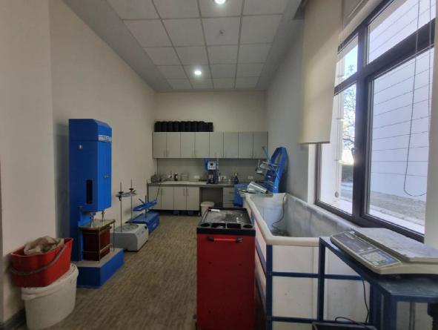
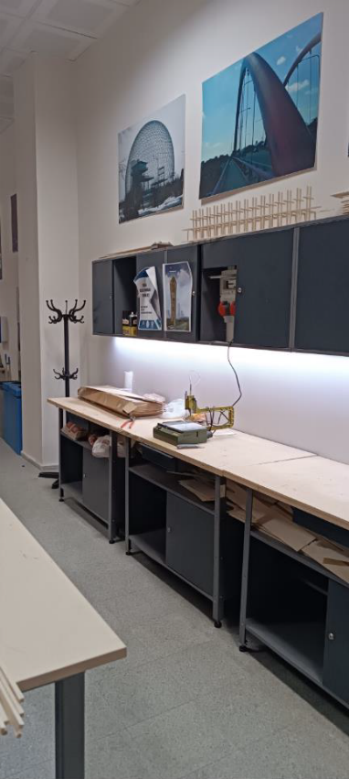
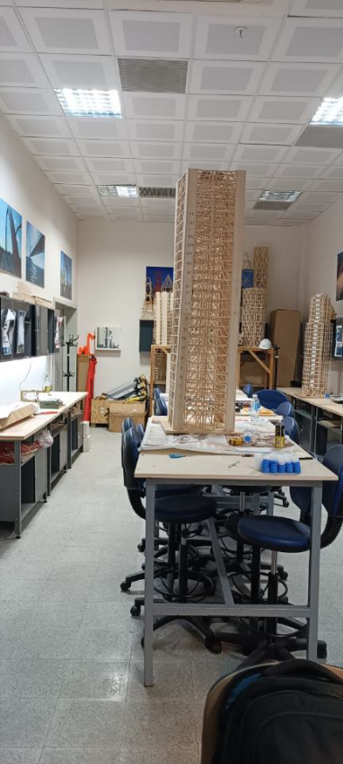
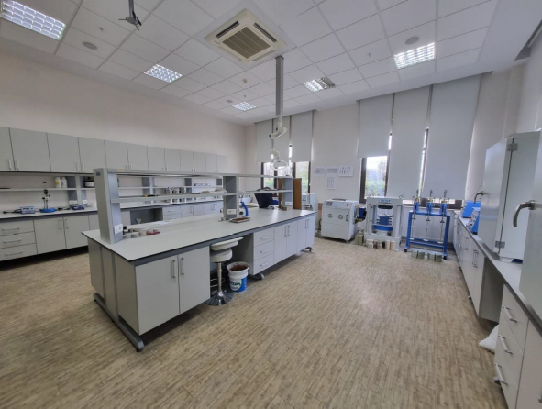
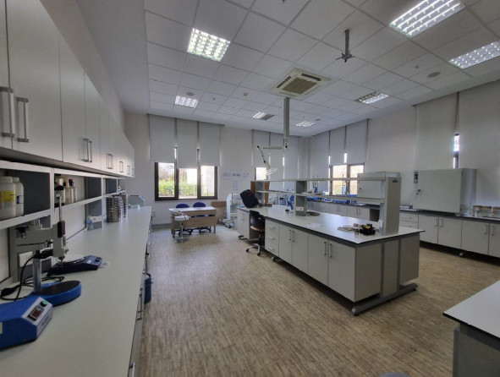
Department Laboratories
Our Department of Civil Engineering laboratory infrastructure is equipped to serve four core sub-disciplines, with two specialized physical laboratories dedicated to different needs. Structural Materials · Geotechnical · Transportation · Hydraulics
AG-18/A Laboratory
Teaching and Practice
BG-03 Laboratory
Project and Research
Designed for use in undergraduate and graduate course experiments, laboratory worksheet exercises, and general teaching activities.
Reserved specifically for our students' project-based work, academic research activities, and innovative applied engineering projects.

Slide 17
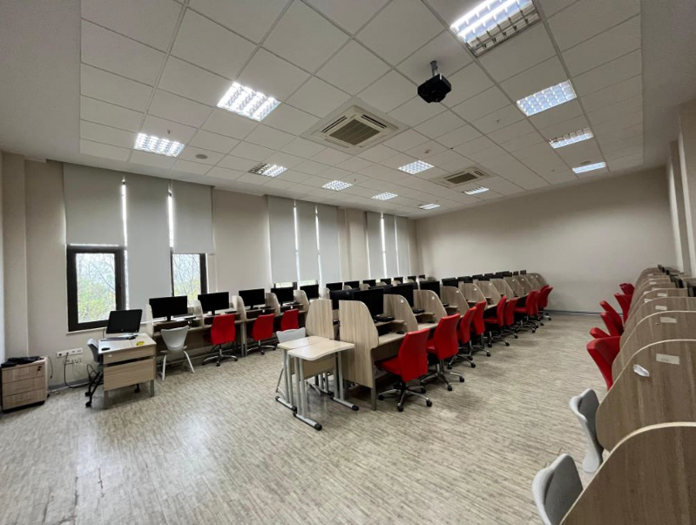
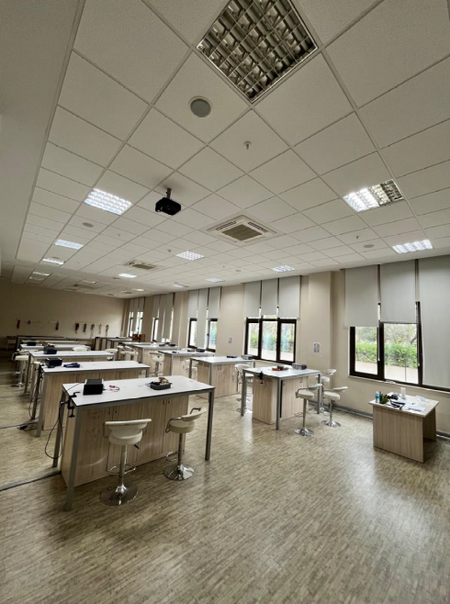
Faculty Laboratories
Computer and general physics laboratories
Computer Laboratories
General Physics Laboratories
203 active computer stations · 5 laboratories
50 student capacity per physics laboratory
Our university has five computer laboratories, along with library computer terminals, available for use by students and faculty.
Physics 1 and Physics 2 lab work is carried out with a rich equipment infrastructure covering mechanics, electricity, magnetism, and electromagnetism.

Slide 18
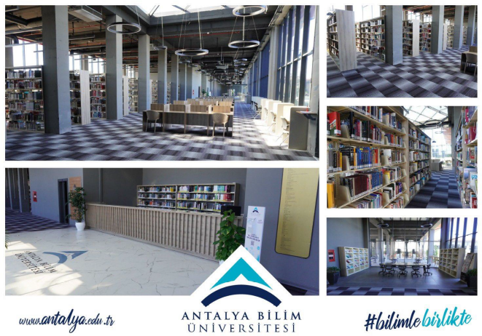

Library
Fettah Tamince Library
Faculty of Engineering students can make use of the Fettah Tamince Library, which serves the Döşemealtı main campus.
24/7 Uninterrupted service year-round, with no difference between term time and holidays
24 hours Monitored by a closed-circuit security system

Slide 19



Career Planning
Career support before and after graduation
Main fields where our graduates work
Site and Project Management
Career Planning Support
Design and Consulting
The Career Planning Application and Research Center, affiliated with the Rectorate, provides career support to students and graduates both before and after graduation. In addition, our department advisors hold one-on-one meetings with students to guide their career plans.
Public Institutions
R&D and Academic Careers

Slide 20
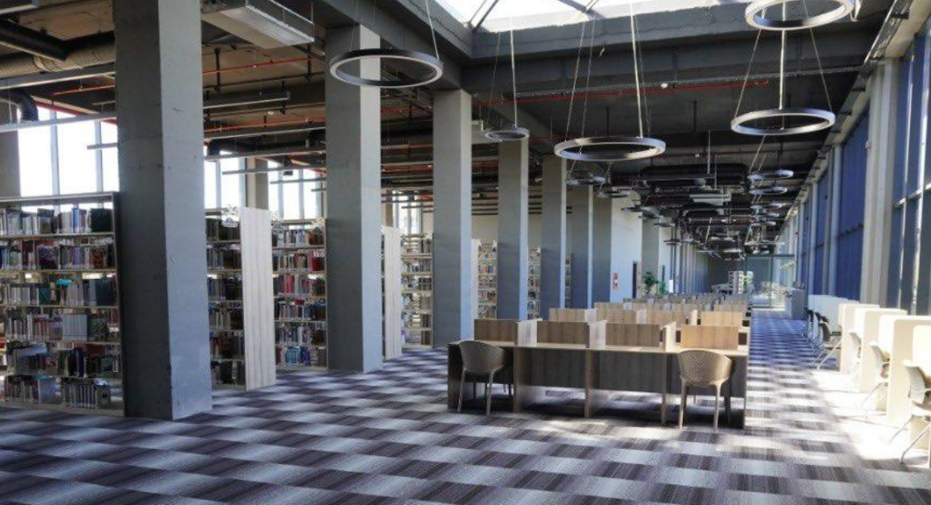


Contact With Us
Department of Civil Engineering · Antalya Bilim University
ADDRESS
Çıplaklı Mah. Akdeniz Bulvarı No: 290/A, 07190 Döşemealtı / Antalya
PHONE
(0242) 245 00 00
EMAIL
necati.agiralioglu@antalya.edu.tr
INSTAGRAM
instagram.com/abu_civil_engineering
Prof. Necati Ağıralıoğlu — Head of Department

